Slide 1

Sazerac SWOT Analysis Using Iowa Liquor Sales Data
By: Mina Saeday
Notes:
This presentation analyzes Sazerac’s sales performance using the Iowa Liquor Sales database and frames the results through a SWOT lens.

Slide 2
scenario
Objective:evaluate Szerac's market position using transaction level sales data
Method: SQL analysis in PG admin, visual summaries in Excel
Focus: strengths,weaknesses,opportunities,and threars tied to revenue,products,geography, and competition
Notes:
My goal was to use SQL to translate raw sales data into business findings that are useful for decision-making.

Slide 3
Summary Stats for DB
Database tables used: sales, products, stores, counties
Primary focus: vendor = Sazerac
Key fields analyzed: revenue, product description, county, store, bottle cost, category
Tools used: PostgreSQL/pgAdmin and Excel
Notes:
The analysis combines transaction data with product, store, and county reference tables to evaluate Sazerac from multiple business angles.

Slide 4
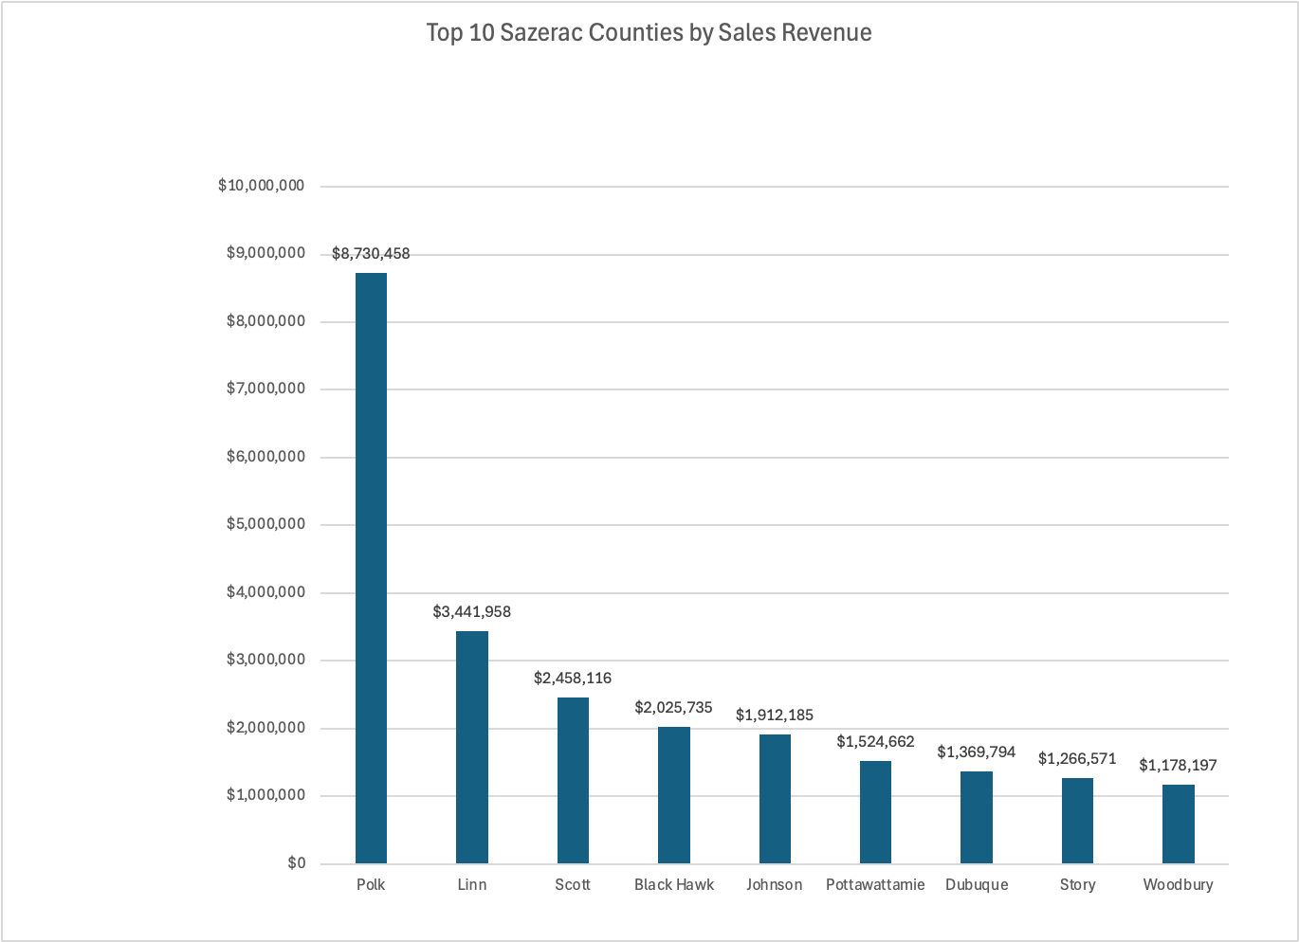
Strength: Strong Geographic Performance
Sazerac revenue is concentrated in high-performing counties, with Polk County clearly leading.
Notes:
This chart shows where Sazerac performs best geographically. Polk County is the strongest market by a wide margin, followed by other high-revenue counties such as Linn and Scott.

Slide 5
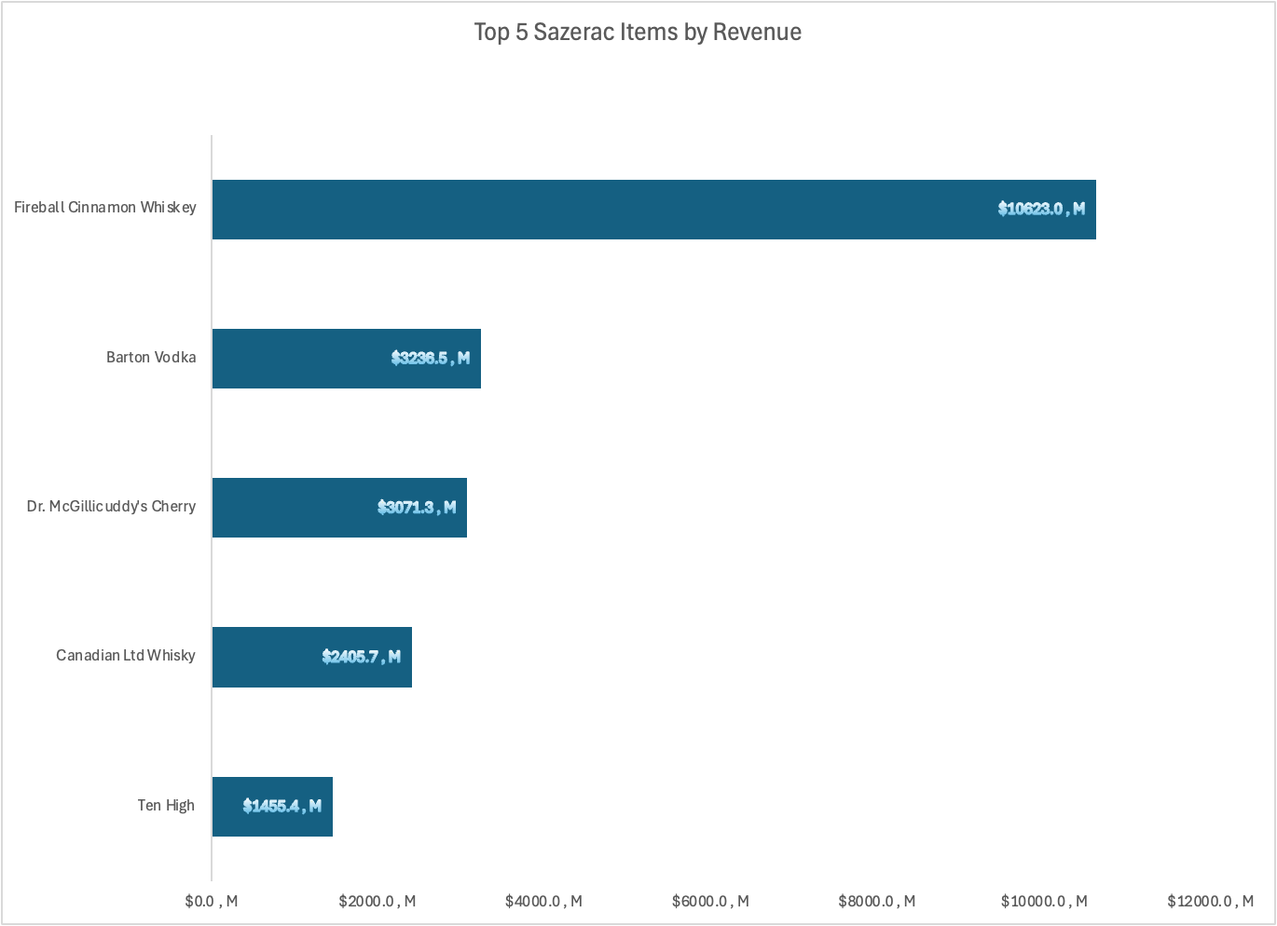
Strength: Clear Hero Products
Revenue is driven by a small set of standout products
Fireball Cinnamon Whiskey is the strongest revenue contributor
Notes:
This result highlights product-level strength. Fireball Cinnamon Whiskey is the dominant revenue driver, which suggests Sazerac benefits from strong flagship-item performance.

Slide 6
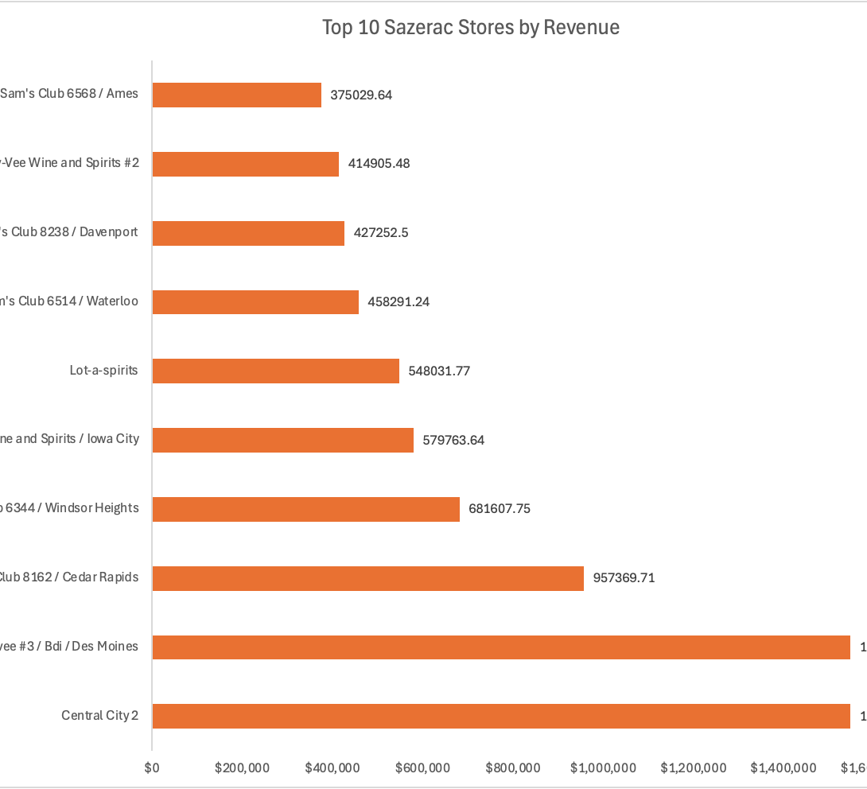
Weakness: Revenue Concentration Across Stores
A relatively small group of stores contributes a large share of revenue
This creates partner concentration risk
Notes:
This chart is useful not only for identifying top partners, but also for showing concentration risk. If a few stores account for a disproportionate share of revenue, Sazerac’s performance becomes more exposed to changes at those retail partners.”

Slide 7
Weakness: Limited Visibility Beyond Active Stores
All observed Sazerac revenue in the filtered dataset came from active stores.
store_status | total_revenue
A | 37256388
Notes:
This result suggests that observed Sazerac revenue is tied entirely to active stores in the dataset. That reduces visibility into any recovery potential from inactive or closed-store channels.

Slide 8
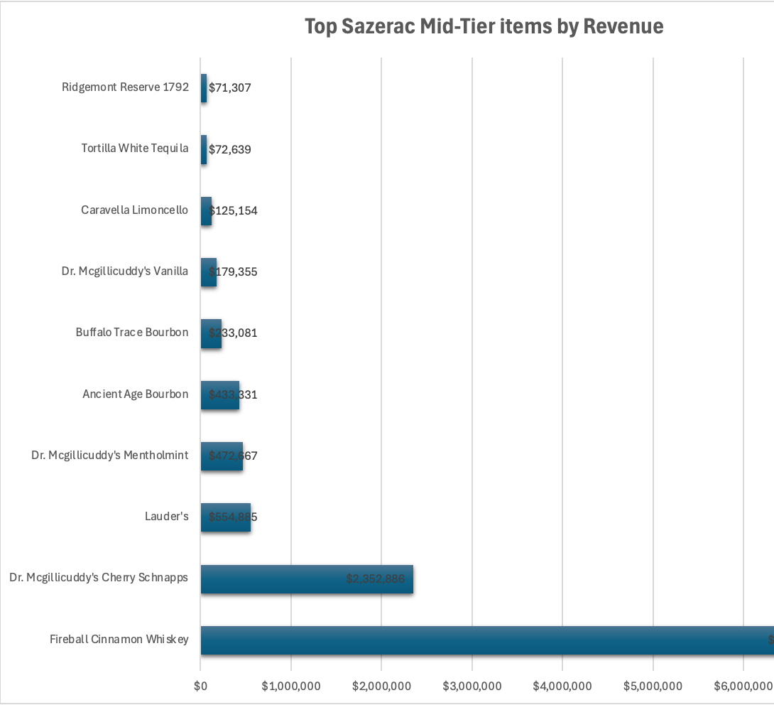
Opportunity: Mid-Tier Price Segment
Mid-tier products generate meaningful revenue
A few items dominate within the $10–$20 state bottle cost range
Notes:
This chart focuses on the mid-tier bottle cost bracket. The opportunity here is that Sazerac already has products performing in this price segment, so there may be room to strengthen positioning around value-oriented but profitable items.

Slide 9
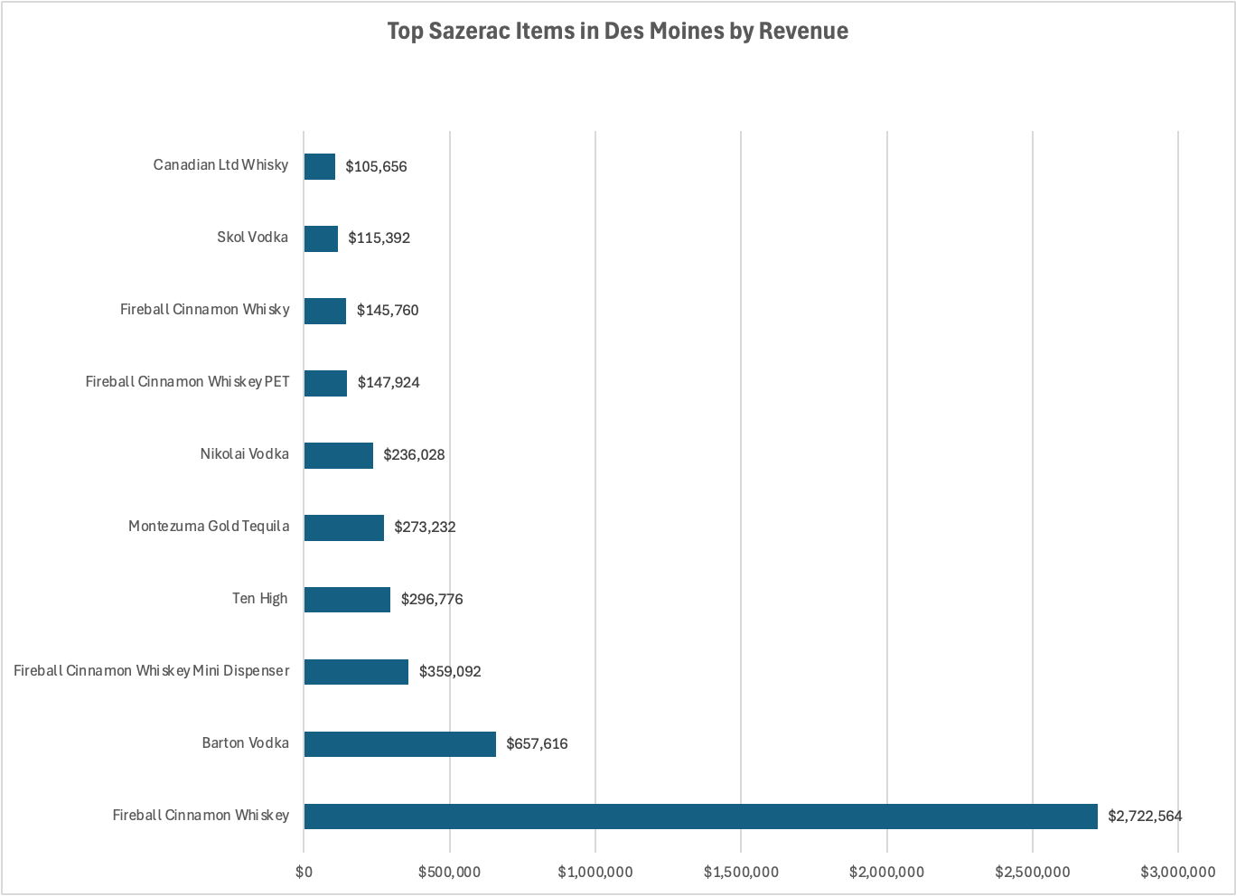
Opportunity: Urban market focus in Deis Moines
Des Moines shows clear product-level demand
Fireball Cinnamon Whiskey leads urban revenue performance
Notes:
This urban-market drill-down shows that Des Moines is not just active, but product-selective. A small number of items, especially Fireball Cinnamon Whiskey, appear to carry the strongest revenue performance in this city.

Slide 10
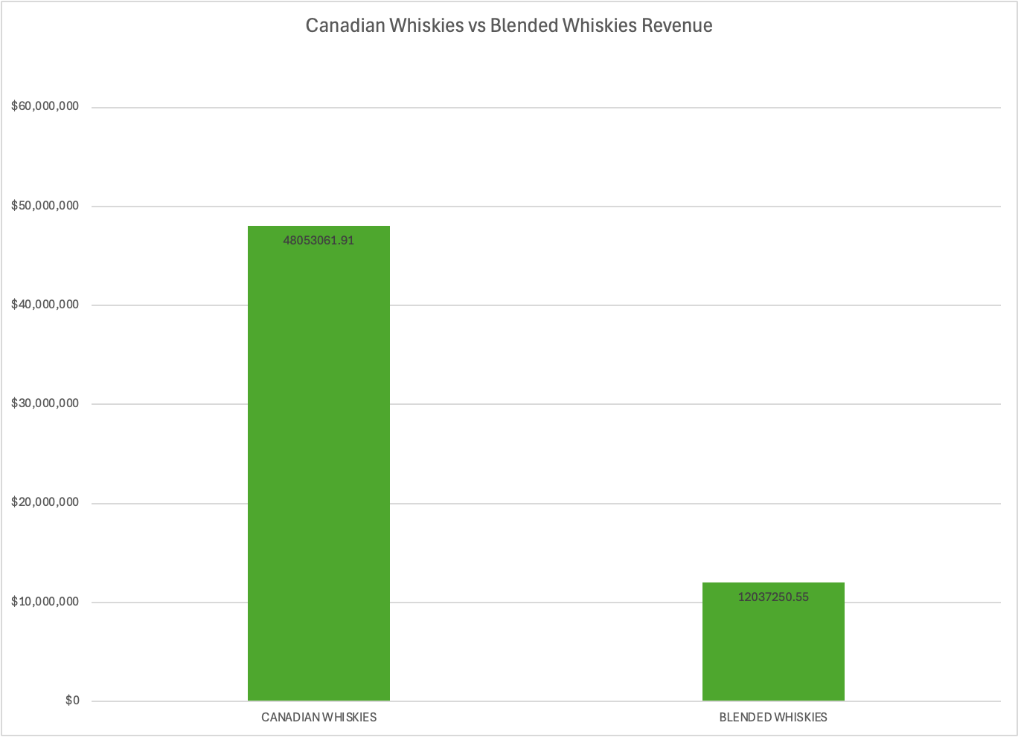
Threat:Competitive Substitute Categories
Canadian Whiskies generate substantially more revenue than Blended Whiskies
Category competition remains important in the substitute space
Notes:
This comparison helps frame the competitive environment. Canadian Whiskies materially outperform Blended Whiskies in this dataset, which indicates a stronger substitute category space and highlights where competition for share is most relevant

Slide 11
THREAT:Limited whitE space in Larger counties
No counties with population over 10,000 were found with zero recorded Sazerac sales
Notes:
This is important strategically. The analysis did not identify any larger-population counties with zero Sazerac sales, which suggests there may be limited untapped white space in major counties. That means future growth may depend more on share expansion than simple geographic entry

Slide 12
SUMMARY AND RECOMENDATION
Defend and deepen share in high-performing counties, especially Polk
1
Prioritize flagship items, led by Fireball Cinnamon Whiskey
2
Expand selectively in mid-tier and urban market segments where demand is already visible
3
Notes:
My recommendation is to protect the core first, especially strong counties and hero products, while using mid-tier pricing and urban-market demand as the main levers for targeted growth.

